Slide 1
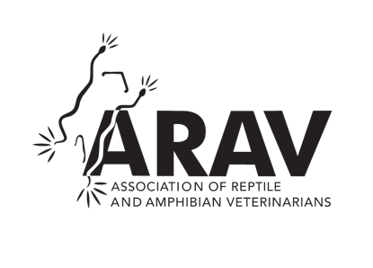
Association of Reptile and Amphibian Veterinarians (ARAV)
Advancing Your Profession

Slide 2
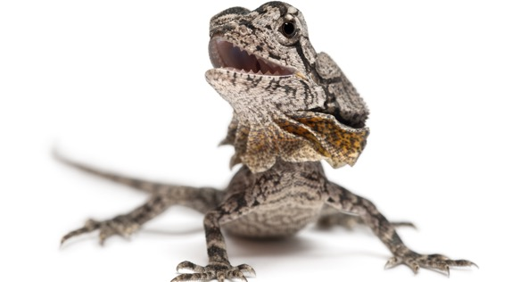
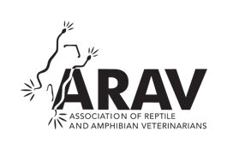
Benefits of Membership
Access to cutting edge publications – easily accessible on-line!
  Journal of Herpetological Medicine and Surgery (JHMS)
  Herp Blerp, the monthly eNewsletter of the ARAV
  Annual conference proceedings
  Infectious disease publication list
  Captive Care and Husbandry Client Brochures
Listing on the Find-A-Vet public directory
  Bring new clients to you!
  International members are listed by country!
Access to ARAV marketing materials
  Promote your involvement and expertise to your clients

Slide 3
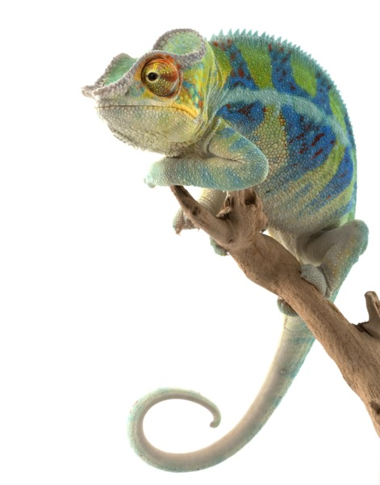
Benefits of Membership
Premier access and opportunity to network with experts in the field of herpetological medicine, helping you learn and grow within the field.
  Members-only Facebook group
  Special International members Facebook group to connect with others near you!
  Reduced conference registration fees for the annual ARAV conference (ExoticsCon) and others, including the iCARE conference in Europe

Slide 4

Benefits of Membership
Get Involved!
  Becoming an active ARAV member will allow you to join any ARAV committee and expand ARAV’s offerings for you and your local and/or international colleagues.
    Use your talents to contribute to meaningful work and connect with leaders in the field
    Influence the changing mission and activities of ARAV as it grows to meet the needs of its membership
Get ARAV involved in a conference or symposia in your local area or country!

Slide 5
Join Today at ARAV.org

