Slide 1
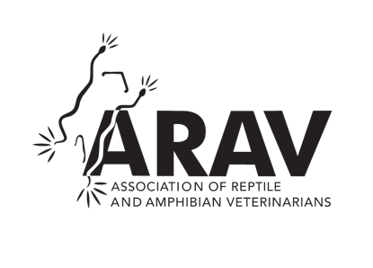
Association of Reptile and Amphibian Veterinarians (ARAV)
Advancing Your Education & Profession

Slide 2
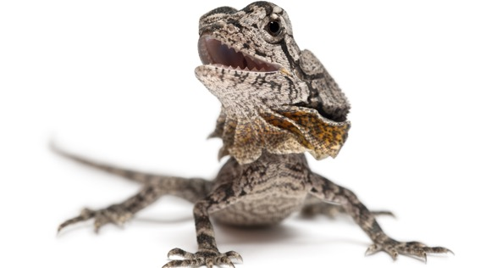
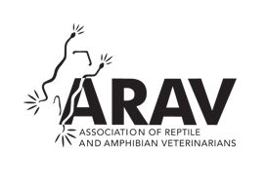
Becoming a Student Chapter
Student Chapter Membership is FREE!
One Student Chapter per veterinary school
Student Chapters have the ability to ask for funding for student symposia given:
An ARAV member is speaking at the conference
ARAV is credited as a sponsor of the event
Take a photo of the ARAV sponsored lecture/lab to display on the ARAV Facebook page

Slide 3
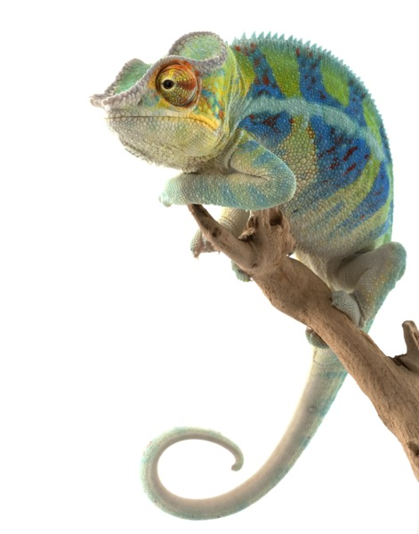
Becoming a Student Chapter
Student Chapters:
May be formed by a group of five (5) or more students at a veterinary school who are interested in reptilian and amphibian medicine and surgery
Have access to the Membership Directory, the ARAV Externship/Speaker database
Get one (1) complimentary student registration to the Annual Conference

Slide 4
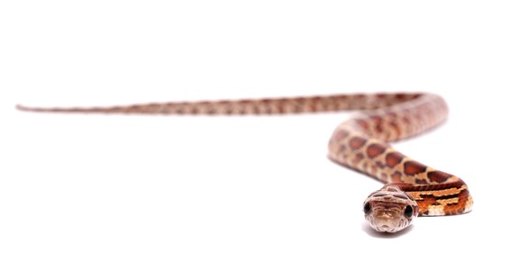
Becoming a Student Member
You will have access to cutting edge publications and resources
Journal of Herpetological Medicine and Surgery
Herp Blerp, the monthly eNewsletter of the ARAV
Annual conference proceedings
Infectious disease publication list
Captive Care & Husbandry Client Brochures
All ARAV marketing materials
You will get premier access and the opportunity to network with experts in the field of herpetological medicine, helping you learn and grow within the field.
You will receive reduced conference registration fees for the annual ARAV conference and others, including the ICARE conferences

Slide 5
Becoming a Student Member
Any Student member who is published in JHMS will get a free year of membership to ARAV!
You have the ability to get involved!
Join a committee!
Use your talents to contribute to meaningful work and connect with leaders in the field
Opportunities in Membership/PR, Legislation and Welfare, Education, fundraising auction, and many others!
Influence the changing mission and activities of the ARAV as it grows to meet the needs of its membership

Slide 6
Join Today at ARAV.org

